Slide 1

QA Project- Salesforce
Katie McCalla
31/03/2021

Slide 2
Introduction + approach
Created a salesforce org to display course and invoices related to the company ForceTraining LTD.
Approached in steps starting with Phase 1 (declarative) and ending with Phase 2 (programmatic).
Used QA project description

Slide 3
Consultant Journey- What have I used and learned?
Salesforce
Visual Studio Code
Git Hub (Online Repository)
Apex, SOQL, Visual Force
Declarative and Programmatic functions.
Including:
Apex Classes, triggers, tests
Visual Force Pages and Custom controller
Flows, processes, approval processes
Custom object creation
Relationships between objects
Page layout, record types
User security
Reports and dashboards
App builder

Slide 4
Custom + Standard objects
Auto_number__c (for generating Invoice numbers in the format EXPINV - 0000 or INV – 0000)
Course_rate__c (Where instructors can set their own daily rate for the course)
Type__c (Defines the duration in days of each course)
Invoice__c (To create invoices and store invoice records)
Invoice_line_items__c(Related to invoices to create and store invoice line items)
Opportunity (Standard object relabelled to ‘Course’ for course record creation)
Account (Standard object for company information)

Slide 5
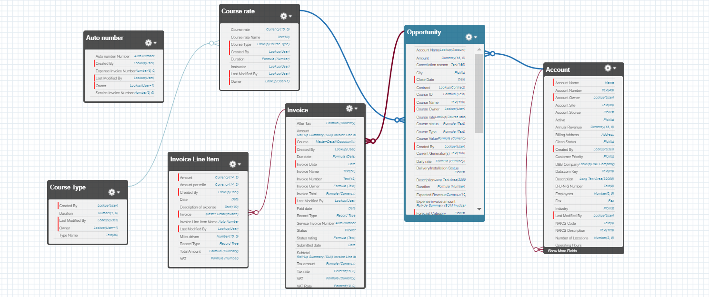
Master-Detail relationship (one to Many) from Courses to invoices and from invoices to Invoice Line Item.

Slide 6
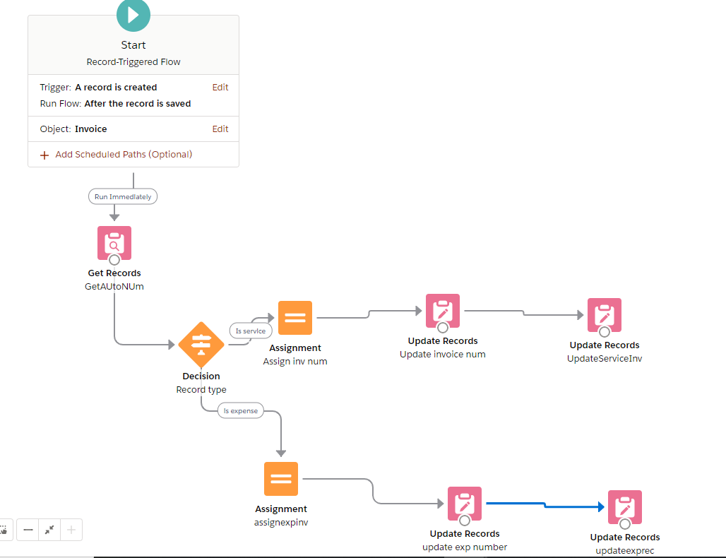
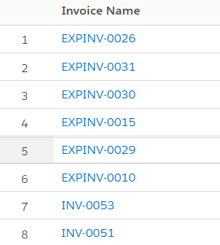
Invoice Name Flow
For service and expense invoices

Slide 7
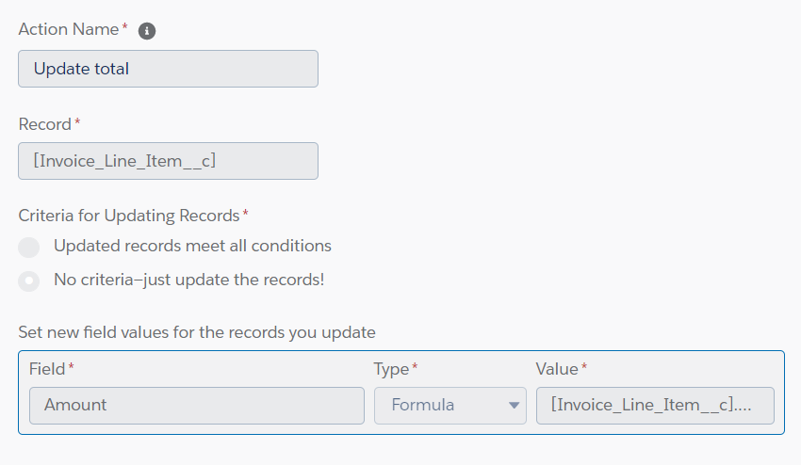
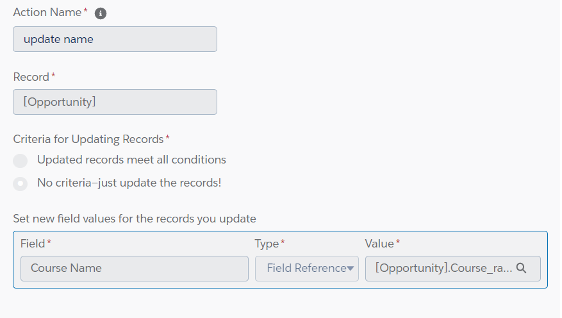
Processes
Processes used include:
Updating the mileage amount for expense invoice related line items
Automated email alert for invoice to be paid
Ensuring the inputted course name matches the course rate name.

Slide 8
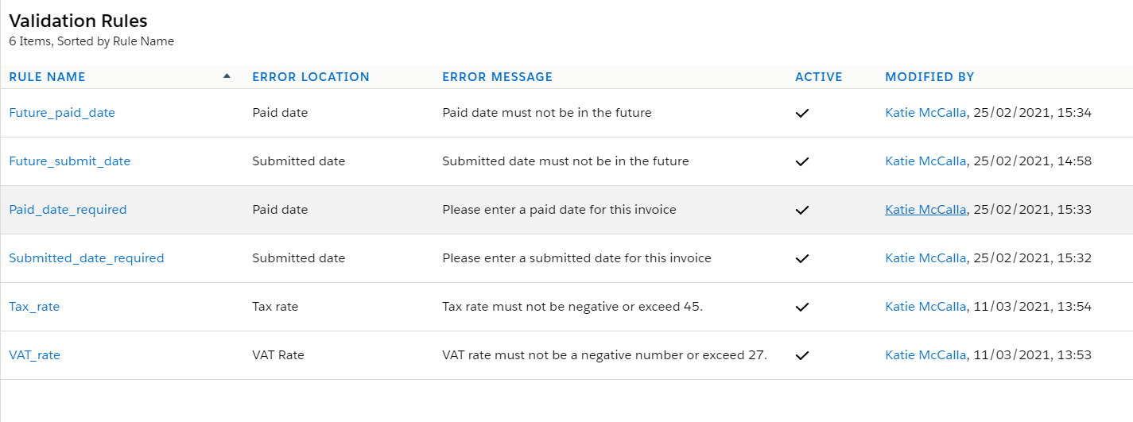
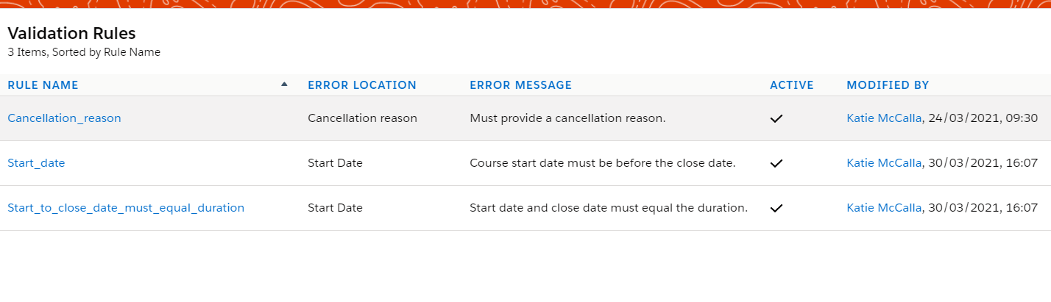
Validation rules
On Invoices
On Courses

Slide 9
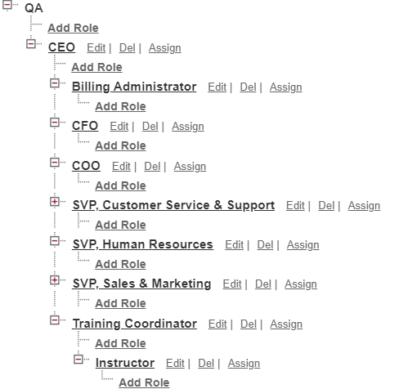
Security
Created 3 custom profiles:
Instructor
Billing Administrator
Training Coordinator
Assigned the appropriate system and object permissions.

Slide 10
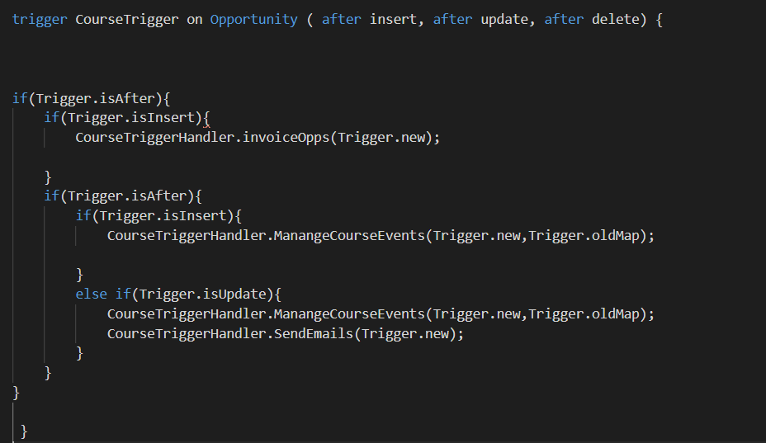
Apex Triggers
To add an invoice to a
Completed course.
Add course to an
Instructors calendar.
Update details on calendar
Event If they change.
Send an email when a course is
Scheduled and cancelled.

Slide 11
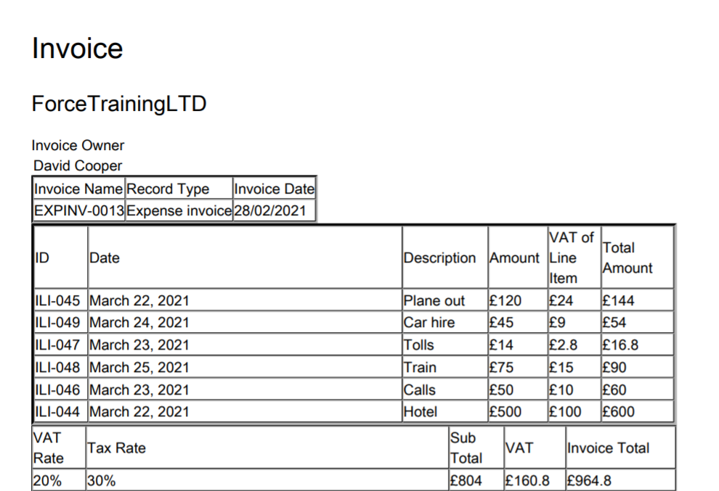
VisualForce Page
To generate a PDF
From invoice using the
Invoice line items.
Activated from a custom
Button on Invoice.

Slide 12
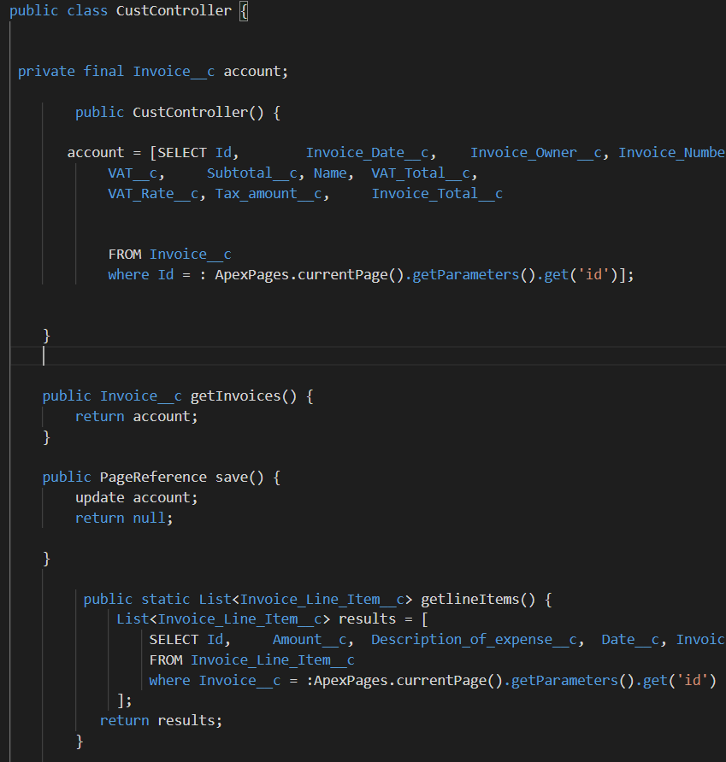
Custom Controller
Custom controller to generate
Invoice PDF with correct information.

Slide 13
Demonstration

Slide 14
Conclusions
What could be improved?
Write and execute more Apex tests. Increase code coverage to 95% (at least 75%)
Automatically create invoice with trigger
- Better CSS styling
Automate cloning of previous invoices
Spend more time on Phase 2.

Slide 15
Reflections and Future steps
Did enjoy this project.
Learnt a lot of new Salesforce tools.
Found the developer guide, salesforce community and trailhead to be very useful and asking for help where necessary.
For the future:
Become more familiar and practice with creating classes, triggers, testing and object relationships.
Practice with CSS.
Ensure I meet all of the requirements in time.

Slide 16
Thankyou
Any questions?

